Slide 1
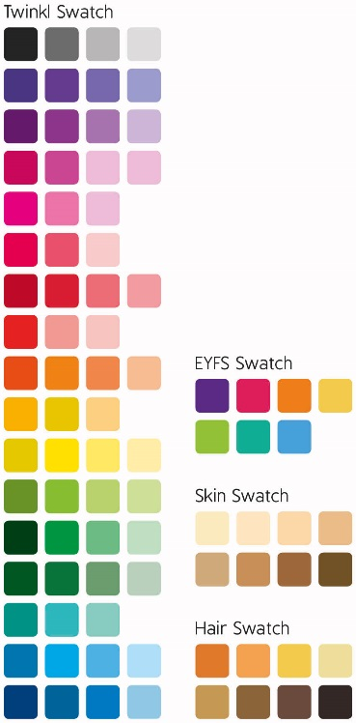

Slide 2
Which picture will we be reading today?
?

Slide 3
Vocabulary Victor wants to know…
Which two adjectives could I use to describe how the children might be feeling?

Slide 4
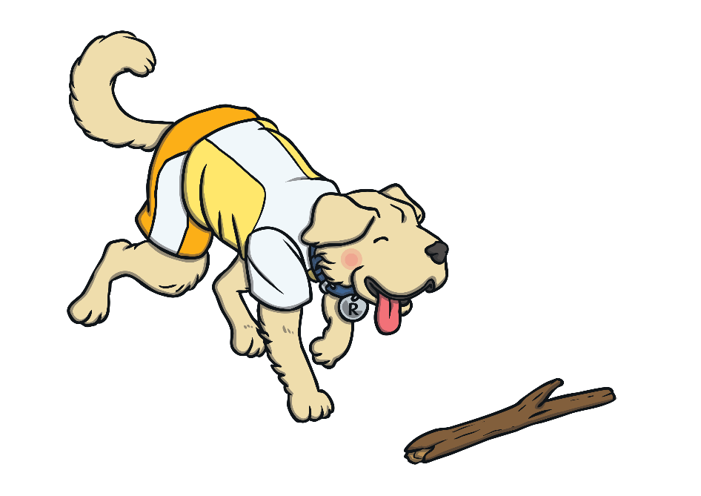
Rex Retriever wants to know…
Who can you see in the picture?

Slide 5
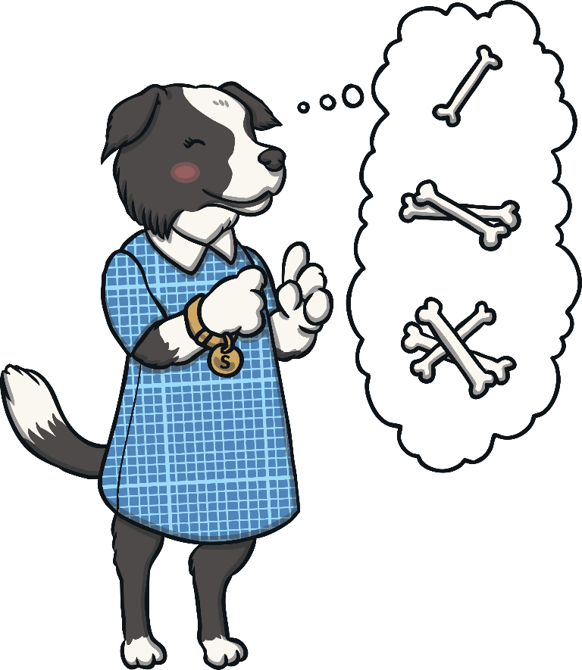
Sequencing Suki wants to know…
How could you use less than 20 words to sum up what you can see in this picture?

Slide 6
Inference Iggy wants to know…
What might the children be looking at on the screen?

Slide 7
Predicting Pip wants to know…
What do you think the children might do next?

Slide 8
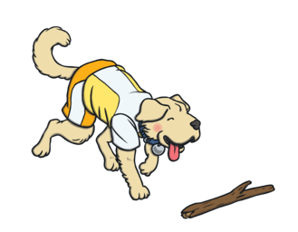
The two adjectives I could use to describe how the children might be feeling are excited and pleased.
In the picture, I can see two children. There is a boy and a girl.
In the picture, I can see two children who look like they are playing on a laptop.
The children might be looking at a video game on the screen.
I think that the children might cheer or laugh and then play another round of the game.

